Slide 2
Test, Visibility and Control

Slide 3
The Vendors
Network Instruments
Leaders in Application Performance
High Speed Forensic Capture
Network & Application Visibility
Reporting
Full Packet Capture to 10Gb Wire Speed (20Gb’s)

Slide 4
The Vendors
Apposite Technologies
Cost effective WAN Emulation up to 10Gb 40Gb
Control bandwidth, latency, jitter and loss
Easy to use interface

Slide 5
The Vendors
Spirent Communications
Unique in delivering hardware cost effective network test platform up to 10Gb aimed at the Enterprise
Includes packet capture, traffic generation & netflow

Slide 6
The Vendors
Bluecoat
Market leaders in WAN Optimisation, Packet Shaping and Web Security
New PacketShaper hardware models lower TCO and deliver 10Gb Visibility and Control

Slide 7
Test
Visibility
Control

Slide 8
Audience Participation!
How many have rolled out 10GB?
Where?
Core Network?
Servers?
Between physical sites?

Slide 9
The challenge…..
Cost
10Gb is becoming more affordable but will come down as the technology matures
Limited adoption in Enterprise
Test, Visibility and Control become more complex

Slide 10
The business drivers…..
Network Refresh
Virtualisation
Business Continuity/Disaster Recovery
Backup

Slide 11
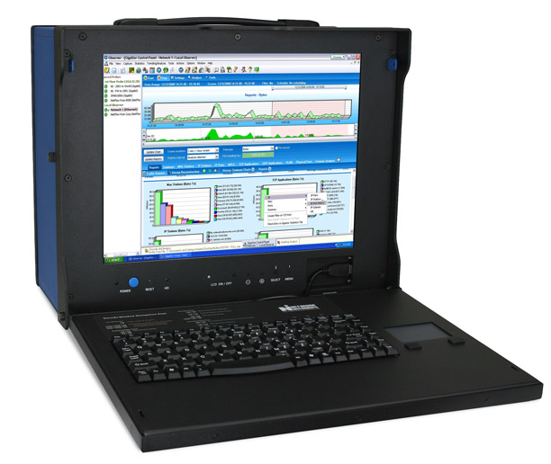
4 Vendors provide a comprehensive solution

